Slide 1

Smart City Utilities Management
A comparative analysis of SQL, NoSQL, and Blockchain data architectures.
DeVos Graduate School, Northwood University
Presented by: Srinivas Bhootam
MIS-659- Relational Database Management

Slide 2
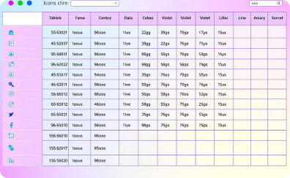
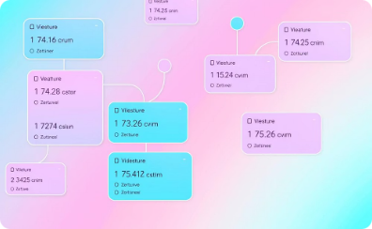



Relational Databases Explained
Data Organization
Data Relationships
SQL Language
Ideal Use
Tables structure data in rows and columns.
Primary and foreign keys link tables.
Used to manage and query data with Structured Query Language.
Best for consistent, structured data with complex queries.

Slide 3
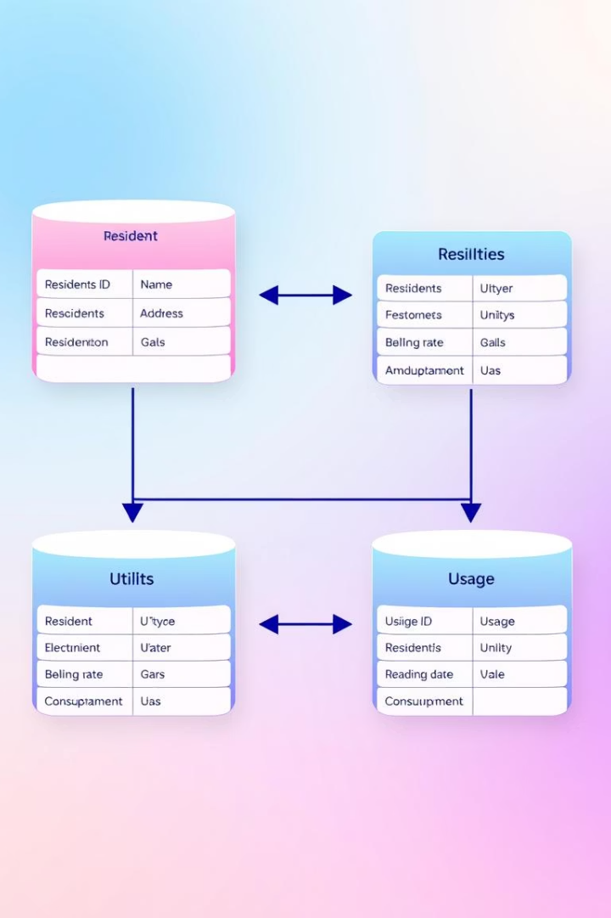
SQL Project: Smart City Utilities Database
Residents Table
Stores personal info of city occupants.
Utilities Table
Details on different utility types provided.
Bills Table
Keeps records of billing data and payments.
Usage Table
Tracks resource consumption by residents.

Slide 4
SQL Practice: Queries & Views
Techniques Practiced
Challenges & Learnings
JOINs to combine multi-table data
Handling foreign key dependencies
Aggregation for totals and averages
Maintaining data normalization
Views for readable summaries
Optimizing query performance

Slide 5
NoSQL Databases Overview
1
2
3
Data Model
Scalability
Data Structure
Schema-less, uses flexible JSON-like documents.
Designed to scale horizontally with ease.
No strict schema or joins; suited for semi-structured data.

Slide 6
NoSQL Project: MongoDB Atlas Implementation
Data Stored
Sample Query
Utility bills and usage per resident.
Queried usage amount greater than 100 units.
Documents embedded in resident collection.
{ "bills.usage.usage_amount": { "$gt": 100 } }

Slide 7

NoSQL Experience Reflection
Easier Aspects
Challenges
No need to define fixed schema
Complex aggregation syntax
Natural nesting of related data
Learning JSON structure intricacies
Learnings
Strong data modeling skills essential for performance.

Slide 8



Blockchain Technology Overview
Immutability
2
Data blocks linked and tamper-proof.
Distributed Ledger
Data shared across multiple nodes.
1
Cryptographic Validation
3
Secure consensus replaces central authority.

Slide 9

Blockchain In-Class Simulation
Block Creation
Constructed blocks with data and hashes.
Chaining Process
Linked blocks ensuring data integrity.
Consensus Understanding
Grasped importance of consensus mechanisms.
Reflection
Blockchain prevents tampering and enhances trust.

Slide 10
Key Takeaways & Reflections
SQL
NoSQL
Blockchain
Robust for structured relational data. Learned strong foundational skills.
Flexible, scalable for diverse data. Emphasized document modeling.
Ensures trust and immutability; complex to implement effectively.
Team favorites: SQL for logic, NoSQL for flexibility, Blockchain for security intrigue.

Slide 11



References
Elmasri & Navathe, 2016:
Fundamentals of database systems, essential for understanding relational models.
Swan, 2015:
Foundational text on blockchain technology and its economic implications.

